Slide 1
SharePoint Framework M5 & M6
Jenkins NS
@jenkinsns

Slide 2

Agenda
Module 5: SharePoint Framework Client Web Parts
What is a Client Web Part?
Creating a project
Exploring Project Contents
Running Your Project
Gulp tasks
Web Part Configuration

Slide 3
What is a Client Web Part?
Client-side web parts are client-side components that run in the context of a SharePoint page. Client-side web parts can be deployed to SharePoint environments that support the SharePoint Framework. You can also use modern JavaScript web frameworks, tools, and libraries to build them.
Client-side web parts support:
Building with HTML and JavaScript.
Both SharePoint Online and on-premises environments.

Slide 4
Creating a SPFx Project
To begin with the development, just make sure that you have the latest node,yeoman, gulp and yeoman SharePoint generator are installed in your machine. These are needed to ensure your machine’s suitability for the development of SharePoint framework offered by Microsoft.

Slide 5
Node_modules, Package.json
Any SharePoint Framework (SPFx) solution that does something useful will use external JavaScript libraries – whether bigger frameworks such as React or Angular, or smaller, more focused libraries such as LoDash, moment.js or something else.
SPFx is based on a node.js-based web stack, the best way to integrate such libraries into your solution is usually to add them from npm, the internet-based package manager for JavaScript.
Npm is effectively an equivalent of NuGet in the .NET world. Once you’re set up with npm, a developer simply runs npm install jquery [or whatever] and the source code for the package will be added to your application’s files.
As is normal with node development, the library is added under the “node_modules” subfolder, and it can now be referenced in your code.

Slide 6
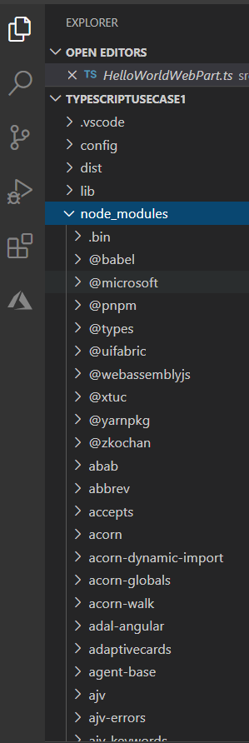
The role of the node_modules folder
The node_modules folder stores all your dependencies. So, it’s a tree structure which can be quite deep. An app which uses jQuery and React for example.

Slide 7
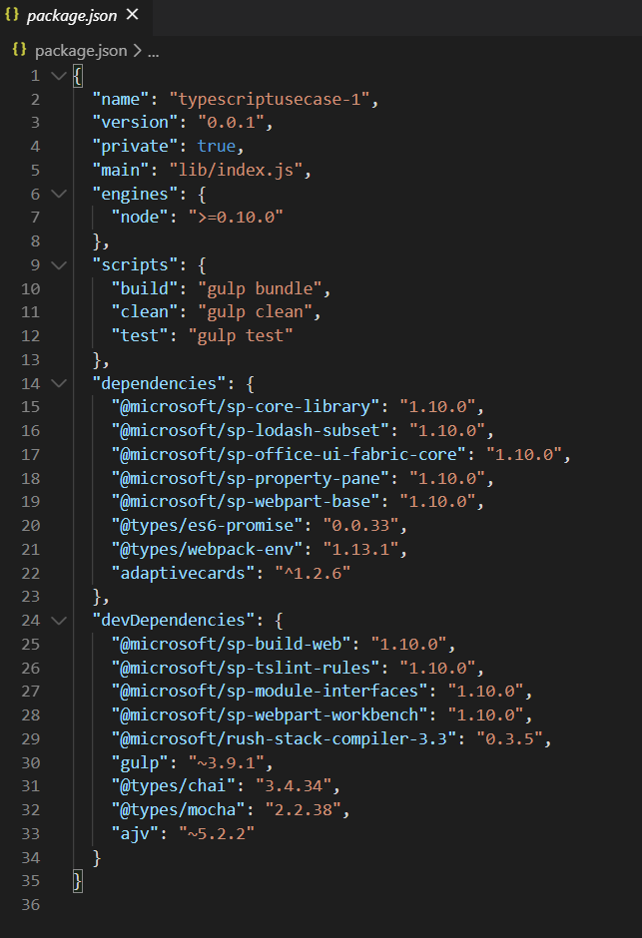
Ensuring dependencies are tracked with package.json
If the --save flag is also specified when adding a package with npm install, an entry is written into the package.json file in the application’s directory. This goes into the “dependencies” section of the file, and will look something like this:

Slide 8
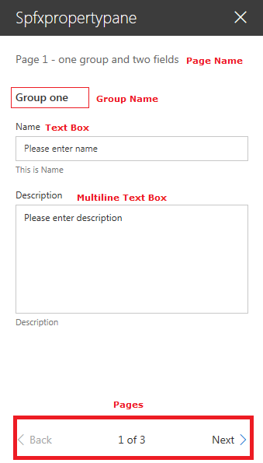
Webpart Configuration
Pages
Pages provide you the flexibility to separate complex interactions and put them into one or more pages. Pages then contain Header and Groups.
Header
Header allows you to define the title of the property pane and Groups let you define the various sections for the property pane through which you want to group your field sets.
Groups
A property pane should contain a page, an optional header, and at least one group. Property fields are then defined inside a group

Slide 9
Webpart Configuration …
Supported Property Fields and Objects
# | Property field | SPFx Typed Object
1 | Label | PropertyPaneLabel
2 | Textbox | PropertyPaneTextField
3 | Multiple lines of text | PropertyPaneTextField
4 | Link | PropertyPaneLink
5 | Dropdown | PropertyPaneDropdown
6 | Checkbox | PropertyPaneCheckbox
7 | Choice | PropertyPaneChoiceGroup
8 | Toggle | PropertyPaneToggle
9 | Slider | PropertyPaneSlider
10 | Button | PropertyPaneButton
11 | Horizontal Rule | PropertyPaneHorizontalRule
12 | Custom | Our own implementation using combination of above

Slide 10
Webpart Configuration …
Property panes allow easy configuration of SPFx client-side web part.
We can use predefined typed objects to create properties for the web part.
Properties can be grouped by pages.

Slide 11
Demo
Lab 8 – Create a Webpart with TypeScript with JSON as Data source

Slide 12
Agenda
Module 6: Client Web Part Properties
Client Web Part Properties
Webpart Properties
Adding Properties
Using Properties
Preconfigured Entries
Dynamic Data
Custom Properties
Advanced Configuration

Slide 13
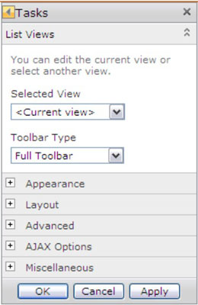
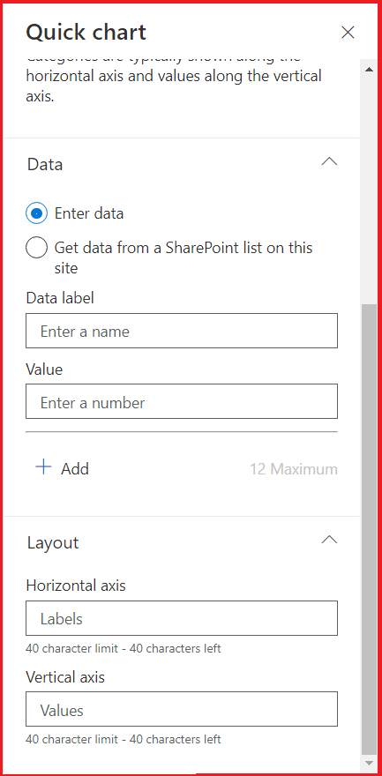
Client Web Part Properties
In classic SharePoint Server web parts can be configured using the properties, generally referred to as WebPart properties. In the SPFx world, they are referred to as property panes. The property panes allow controlling the behavior and appearance of a web part.
The Modern SharePoint Framework have a new WebPart Property pane. The property pane allows end users to configure the web part with a bunch of properties.

Slide 14
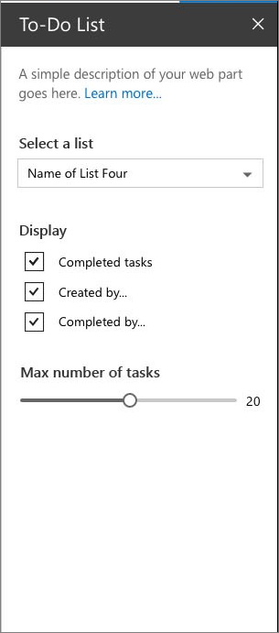
Webpart Properties
The Modern SharePoint Framework have a new WebPart Property pane for WebPart Properties.
The property pane has three key metadata:
Pages
Pages provide you the flexibility to separate complex interactions and put them into one or more pages. Pages then contain Header and Groups.
Header
Header allows you to define the title of the property pane and Groups let you define the various sections for the property pane through which you want to group your field sets.
Groups
A property pane should contain a page, an optional header, and at least one group. Property fields are then defined inside a group

Slide 15
Webpart Properties
Supported Property Fields and Objects
# | Property field | SPFx Typed Object
1 | Label | PropertyPaneLabel
2 | Textbox | PropertyPaneTextField
3 | Multiple lines of text | PropertyPaneTextField
4 | Link | PropertyPaneLink
5 | Dropdown | PropertyPaneDropdown
6 | Checkbox | PropertyPaneCheckbox
7 | Choice | PropertyPaneChoiceGroup
8 | Toggle | PropertyPaneToggle
9 | Slider | PropertyPaneSlider
10 | Button | PropertyPaneButton
11 | Horizontal Rule | PropertyPaneHorizontalRule
12 | Custom | Our own implementation using combination of above

Slide 16
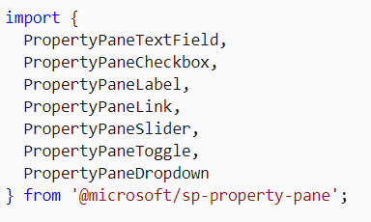
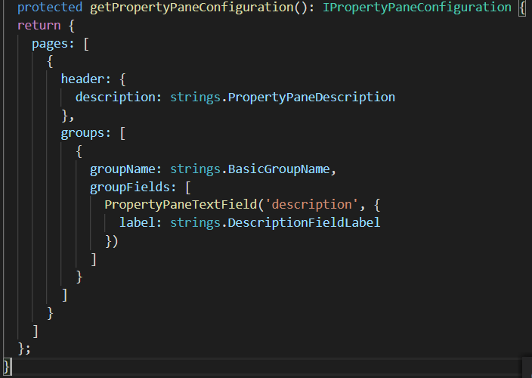
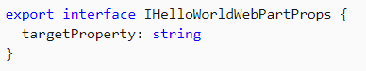
Adding & Using Properties
The field types are available as modules in @microsoft/sp-property-pane. You need to import the objects into a module before you can use them in your web parts.
Note: The property pane objects were split out into their own module, @microsoft/sp-property-pane, in the SharePoint Framework v1.9 release. Prior to this, they were included in the @microsoft/sp-webpart-base module.
Every field type method is defined as follows, taking PropertyPaneTextField as an example →
The targetProperty defines the associated public property on the web part for that field type and is also defined in the props interface in your web part.
To assign types to these properties, define an interface in your web part class that includes one or more target properties.
<p class="${ styles.description }">${escape(this.properties.description)}</p>

Slide 17
Custom Properties
The SharePoint Framework contains a set of standard controls for the property pane. But sometimes you need additional functionality beyond the basic controls. You might need asynchronous updates to the data on a control or a specific user interface. Build a custom control for the property pane to get the functionality you need.

Slide 18
Demo
Lab 9 – Create a Web Part with all Properties
Lab 10 – Custom Properties
Lab 11 – Dynamic data in Properties

Slide 19
References

Slide 20



Official Blog
dev.office.com/blogs
Twitter
@OfficeDevPnP
Tech Community
aka.ms/sppnp-community

